Slide 1
To Responsibly Fast-Forward How (not) to ‘Try First and Ask for Forgiveness Later’
Developing the design-framework for responsible on-campus-experimentation …
Project leader: prof.dr. Michiel A. Heldeweg LLM
Chair in Law, Governance & Technology

Slide 2
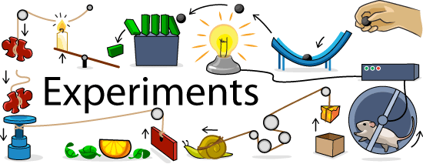
To Responsibly Fast-Forward How (not) to ‘Try First and Ask for Forgiveness Later’
Experimentation….
Achieving disruptive technological innovations often requires an experimental phase for development and use, ‘in vivo’.
Such experimentation may be in conflict with existing rules (e.g. safeguarding safety, privacy, security, nuisance and economic assets) and principles (e.g. equality, legal certainty, proportionality)

Slide 3
To Responsibly Fast-Forward How (not) to ‘Try First and Ask for Forgiveness Later’
Experimental Exceptions….
Existing rules may need to be set aside temporarily to create a legal niche in which these experiments can still take place.
Experimental rules may allow ‘experimental space’ safeguarding key legal values and also secure epistemic values (to yield information towards upscalable findings)

Slide 4
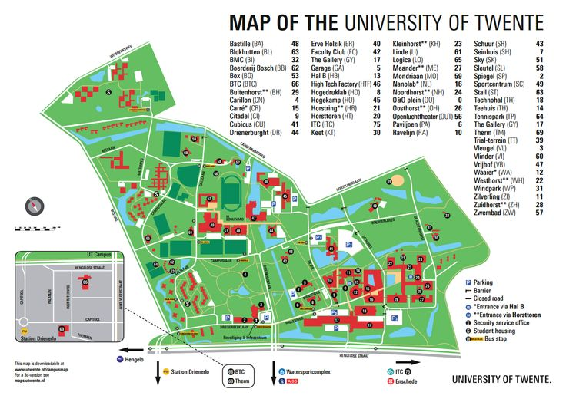
To Responsibly Fast-Forward How (not) to ‘Try First and Ask for Forgiveness Later’
Experimental space & regime
The campus is an attractive spatial niche for experimentation, against background of research, design & development in silico and/or in vitro, to small scale in vivo experimentation (before larger scale experimetation, e.g. ‘Enschede’, and ultimate upscaling).
Twofold approach: Bottom-up & Top-down

Slide 5
To Responsibly Fast-Forward How (not) to ‘Try First and Ask for Forgiveness Later’
Two approaches to responsible on-campus experimentation…
Bottom-up responsibility (smart self-regulation): try first and ask for forgiveness later’, but perhaps consider what code of conduct may enhance both epistemic & legal values (including stakeholder involvement) for experimenting on-campus
Top-down responsibility (being regulated, but smart): flexible / future proof arrangements, such as a integrated license for on-campus experimentation. Seek to engage with public authorities (e.g. Enschede) towards such arrangements.

Slide 6
To Responsibly Fast-Forward How (not) to ‘Try First and Ask for Forgiveness Later’
Two year project
‘Developing the design-framework for responsible on-campus-experimentation …’ Deliverables...
- An ethical/legal code of conduct (due-diligence without license)
- Possibilities for a campus-wide integrated experimental license
Engage staff and students, as well as campus management....
Involve upscaling perspective: MoU Enschede; Field Labs MinEZ

Slide 7
To Responsibly Fast-Forward How (not) to ‘Try First and Ask for Forgiveness Later’
Application
NWO-MVI research on responsible development & use of drones (Verbeek, Van der Molen, Heldeweg; ….. )
Tech4People research RegTech & Robotics, especially care robotics (Fosch Villaronga, Heldeweg ….. )
Potential links with other LSC-projects
Privacy-preserved crowd monitoring (is there scope for moving experimentally moving beyond what is legally allowed?)
Driverless cars (as during CuriousU), wearables; chipping…personal data... Open invitation

Slide 8
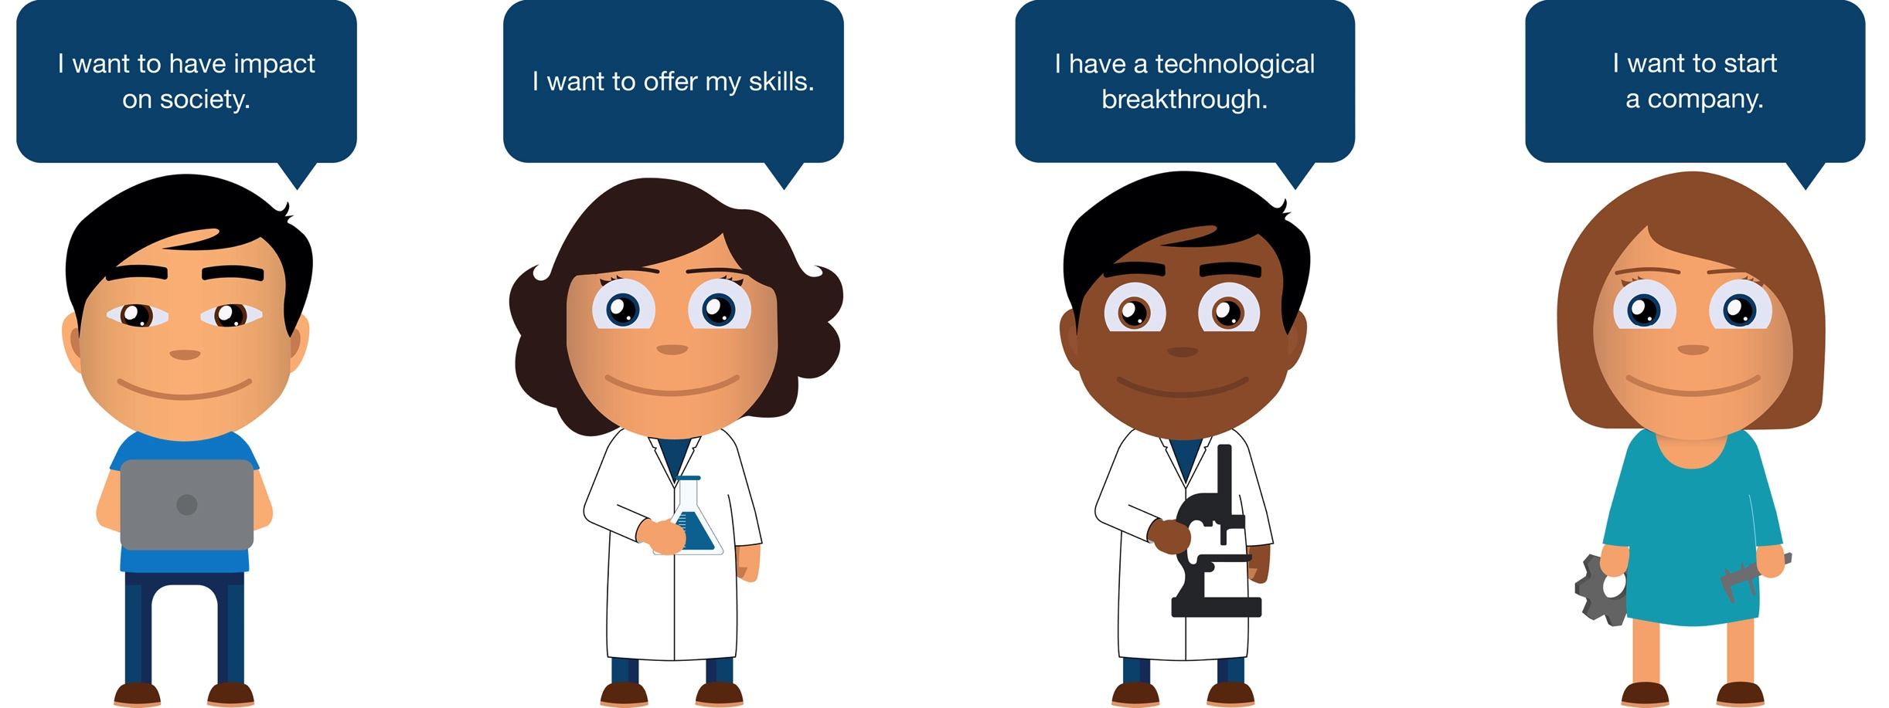
To Responsibly Fast-Forward How (not) to ‘Try First and Ask for Forgiveness Later’
Researchers involvement
NWO-MVI responsible development & use of drones & Tech4People research project
Ongoing research on legal regimes for experimentation of the Chair in Law, Governance & Technology (Heldeweg)
Students involved in
- Public Administration course Smart rules and regimes will look at ‘regulating robotics’, amongst which experimental settings, such as on campus..
MSc-theses work on LSC & experimentation

Slide 9
To Responsibly Fast-Forward How (not) to ‘Try First and Ask for Forgiveness Later’
In January 2017 a further, more elaborate operational plan will be presented…

